Slide 1

Robot Operating system
ROS CONtrol
Lecturer: Dr. Bui Ha Duc
Dept. of Mechatronics
Email: ducbh@hcmute.edu.vn

Slide 2
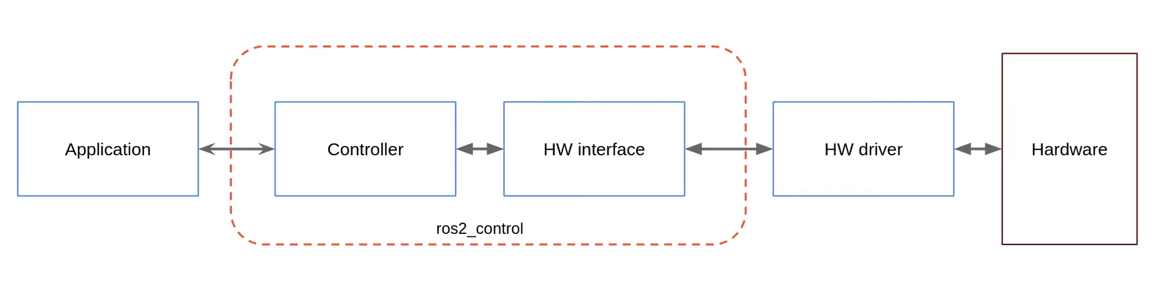
Control your robot
ros_control is a framework in the ROS)designed to bridge the gap between high-level robot software (e.g. navigation) and the low-level hardware (e.g. motors, encoders, and sensors).
ros_control is designed to be compatible with real-time kernels (like PREEMPT_RT) → Real-time safety
For more detail refer to https://control.ros.org/rolling/doc/getting_started/getting_started.html

Slide 3
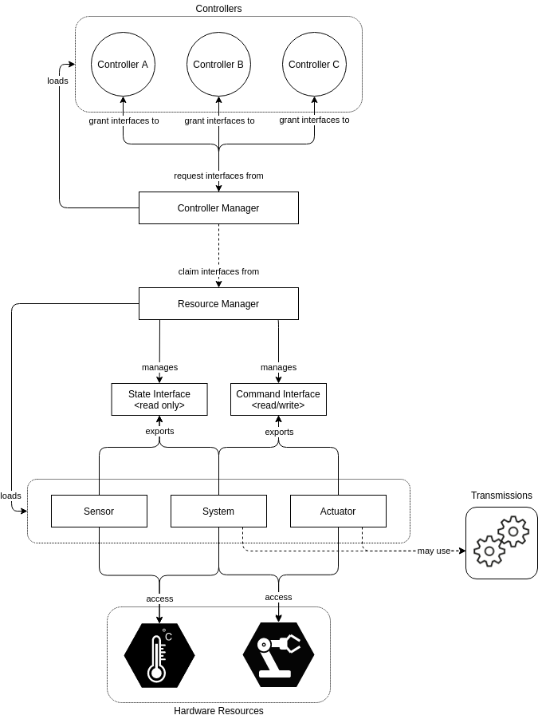
ROS Control Components
4. Controllers
3. Control Manager
2. Resource Manager
1. Hardware Interface

Slide 4
ROS Control Components
Hardware interface
C++ plugin that acts as the "translator" between the ROS world and the physical (HW) world
Core Method:
  read(): Fetches raw data from the hardware and stores it in memory
  write(): Sends calculated commands from memory to the hardware.
This plugin is specified inside the <hardware> tag of the robot URDF.

Slide 5
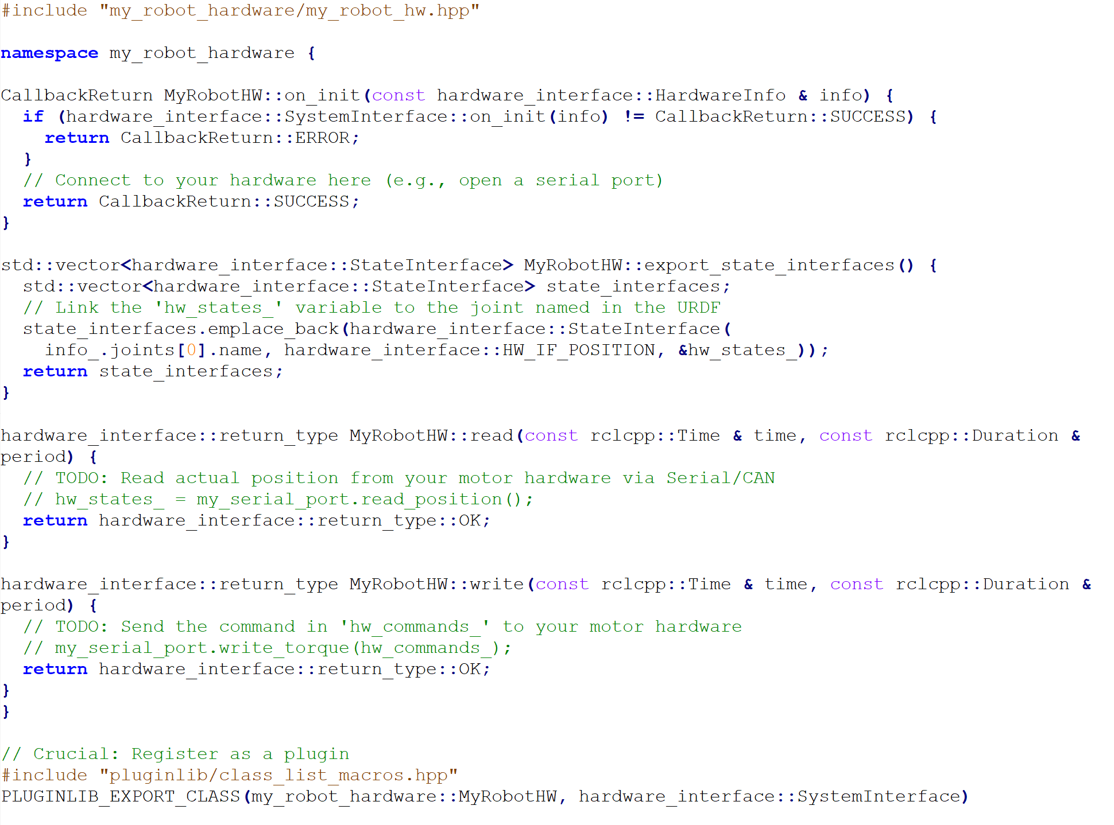
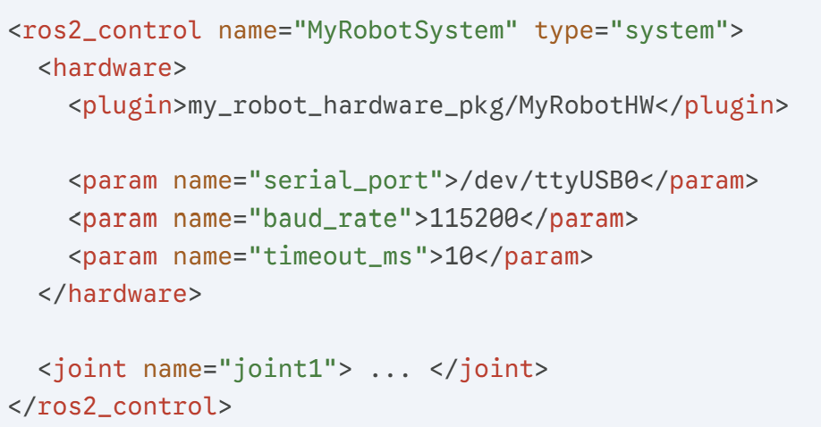
ROS Control Components
For Real Robot
URDF define
C++ interface

Slide 6
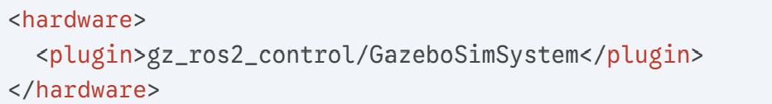
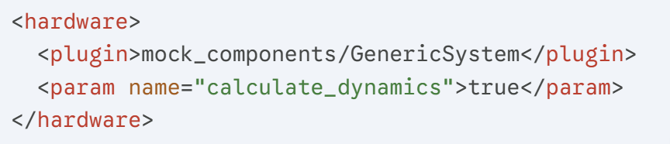
ROS Control Components
For Gazebo Sim
For Mock hardware (testing)

Slide 7
ROS Control Components
2. Resource Manager
Resource Manager manages the state of the hardware by creating a shared memory space where hardware data is stored
  Command interfaces: hardware → controller
  State Interfaces: controller → hardware
Resources Manager ensures hardware data is available for any controller to read simultaneously.
ROS automatically parses the robot URDF and build this memory map

Slide 8
ROS Control Components
3. Controller Manager
Controller manager is the "Heart" of the ROS 2 Control
It manages the timing of the real-time loop, in each cycle:
  It tells the Hardware Interface to read() from hardware
  tells the Controllers run update() function for active controller
  tells the Hardware Interface to write() the results back to the hardware
It exposes ROS services so user can load, start, or stop controllers while the robot is running
Controller manager is configured via a YAML file where you list your controllers and their update rates

Slide 9
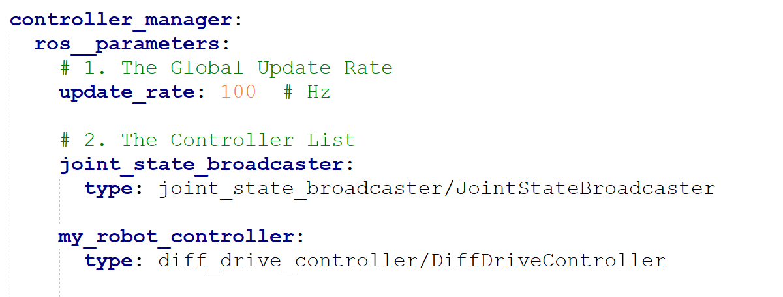
ROS Control Components
The YAML file is the configuration blueprint for Control manager
YAML file is divided into two main sections:
  Controller Manager's parameters
Notes:
Low rate (e.g., 10-50 Hz): Good for slow movements or high-latency hardware.
High rate (e.g., 100-1000 Hz): Required for dynamic stability, high-speed balancing, or complex manipulation.
Note: Your hardware communication must be fast enough to finish within this window. If you set $100$ Hz, your read() and write() together must take significantly less than $10$ ms.

Slide 10
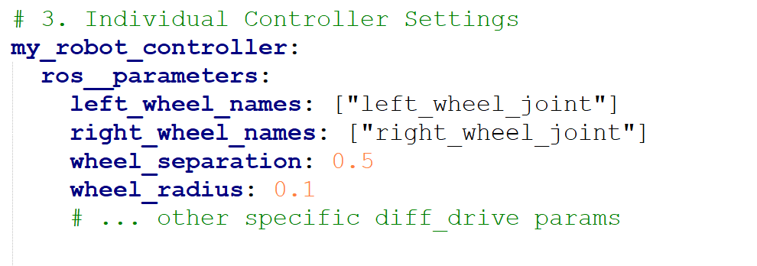
ROS Control Components
  Individual parameters for each controller

Slide 11
ROS Control Components
4. Controllers
Controllers are modular plugins that process data from hardware
  Broadcasters: (e.g., JointStateBroadcaster) Read state interfaces and publish them to topic /joint_states
  Command Controllers: (e.g., DiffDriveController, JointTrajectoryController) Take high-level goals and calculate the specific motor commands (Position, Velocity, or Effort).
Controller They take a "Goal" (e.g., "Go 1.0 m/s") and compare it to the "State" (e.g., "Currently going 0.8 m/s") to calculate the command needed to close the gap

Slide 12
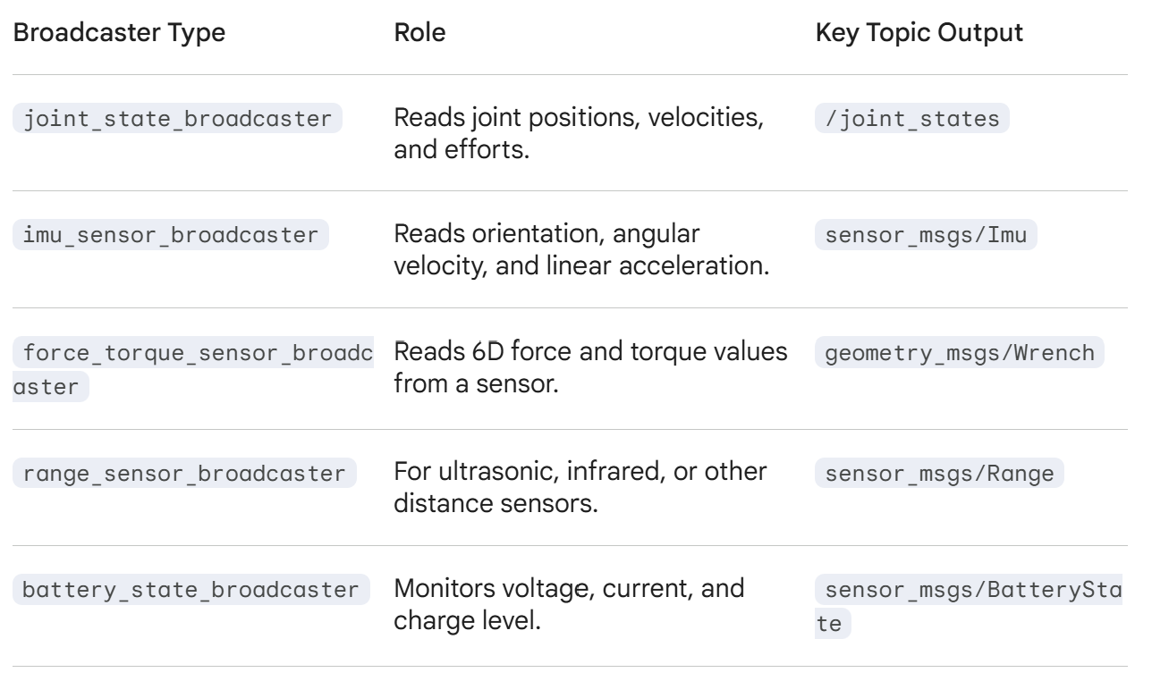
ROS Control Components
Broadcasters

Slide 13
ROS Control Components
Simple controller (Effort/Velocity/Position)
Feature | Position Controller | Velocity Controller | Effort Controller
Primary Goal | Reaching a specific target angle or coordinate. | Maintaining a specific speed over time. | Applying a specific force or torque.
Common Plugin | position_controllers/JointGroupPositionController | velocity_controllers/JointGroupVelocityController | effort_controllers/JointGroupEffortController
Input (ROS Topic) | std_msgs/Float64MultiArray (Target positions) | std_msgs/Float64MultiArray (Target speeds) | std_msgs/Float64MultiArray (Target Newtons/Amps)
Output (Hardware Interface) | <command_interface name="position"> | <command_interface name="velocity"> | <command_interface name="effort">
Robotics Use Case | Robotic arm joints (SCARA, 6-DOF), Grippers, Steering angle. | Mobile robot wheels (Diff-Drive), Conveyors, spinning LiDAR. | Research: Gravity compensation, force-feedback, balancing robots.
Real-time Feel | "Stiff" and precise. | Smooth and continuous. | "Soft" or compliant (Physical interaction).
https://control.ros.org/rolling/doc/ros2_controllers/doc/controllers_index.html

Slide 14
ROS Control Components
Controller Name | Primary Robot Type | Input Interface (ROS) | Internal Logic / Kinematics | Output Interface
diff_drive_controller | Mobile Robots (2-wheel, Skid-steer) | geometry_msgs/Twist ($x$, $z$ velocity) | Differential drive kinematics; calculates wheel velocities; computes Odometry. | velocity
joint_trajectory_controller | Robotic Arms / Multi-joint Manipulators | trajectory_msgs/JointTrajectory (Waypoints + Time) | Spline Interpolation (cubic/quintic) to ensure smooth, synchronized motion across all joints. | position, velocity, or effort
tricycle_controller | 3-Wheeled Robots (1 steered/driven, 2 trailing) | geometry_msgs/Twist | Maps base velocity to a steering angle and traction speed for the front wheel. | position (steer) and velocity (drive)
bicycle_steering_controller | Car-like Robots (Ackermann) | geometry_msgs/Twist | Implements Ackermann geometry for a traction joint and a steering joint. | position (steer) and velocity (drive)
gripper_action_controller | End Effectors / Claws | control_msgs/GripperCommand | Provides an Action interface; handles Stall Detection to know when an object is grasped. | position
admittance_controller | Human-Robot Interaction / Assembly | geometry_msgs/Wrench (Force/Torque) | Converts sensed external forces into compliant movement (simulating "softness"). | position or velocity

Slide 15
ROS Control Components
5. Topics
Topic exposes the controllers to the rest of the ROS system
This layer is not real-time;
Common topics/services:
  /joint_states : contain name, position, velocity, effort of joints
  /cmd_vel: control mobile robot, contain vx, vy, heading angle
  /odom: mobile robot odometry
  /tf: link transform

Slide 16
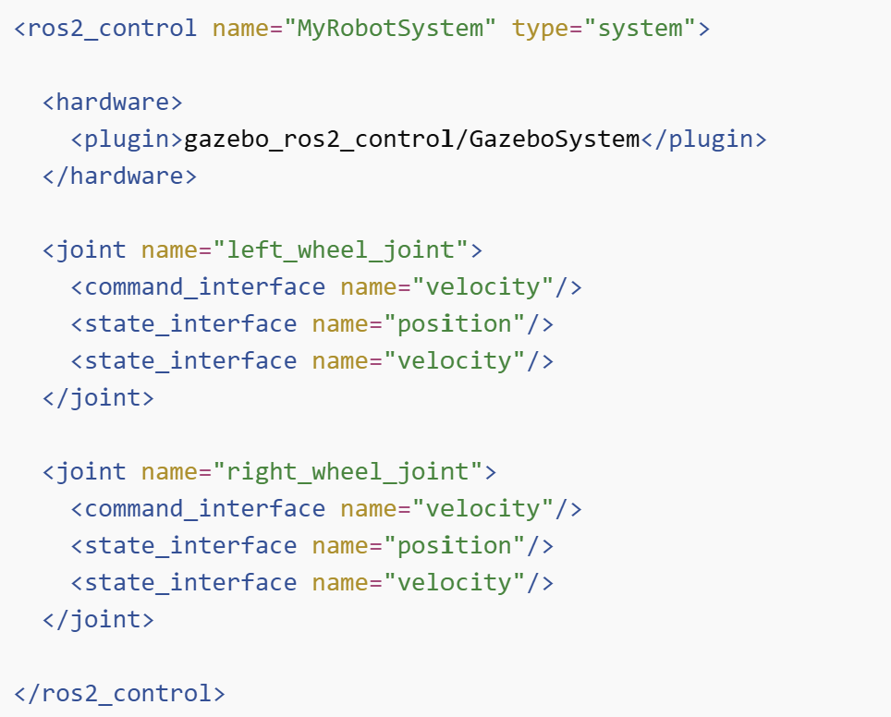
Implementing ROS Control
Step 1: Add Ros2_control to the robot URDF
  Tell the ros2_control which joints exist, what command they accept, what state they publish

Slide 17
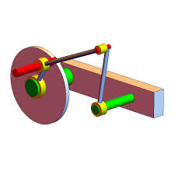
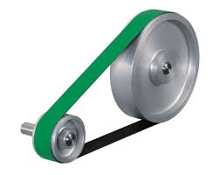
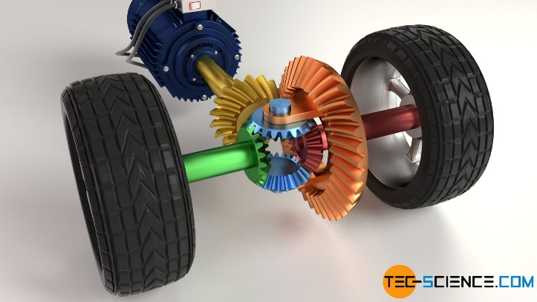
Implementing ROS Control
Step 2: Add transmission if needed
  SimpleTransmission: A simple transmission with a constant reduction ratio and no additional dynamics.
  DifferentialTransmission: A differential transmission with two actuators and two joints
  FourBarLinkageTransmission: A four-bar-linkage transmission with two actuators and two joints

Slide 18
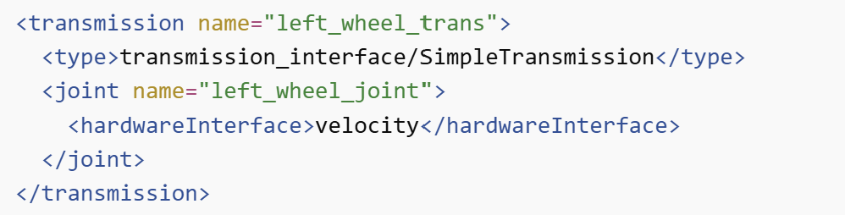
Implementing ROS Control
Example of simple transmission

Slide 19
Implementing ROS Control
Step 3: Add hardware interface

Slide 20
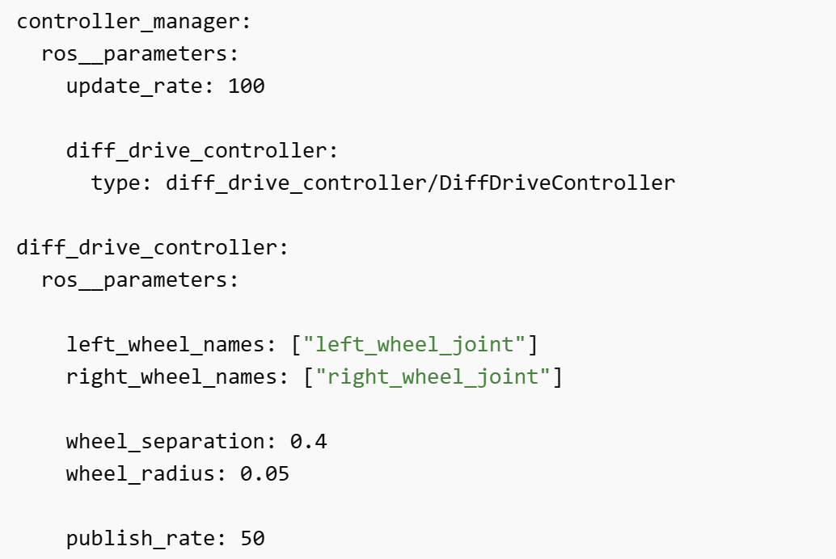
Implementing ROS Control
Step 4: Create controller configuration (YAML)

Slide 21
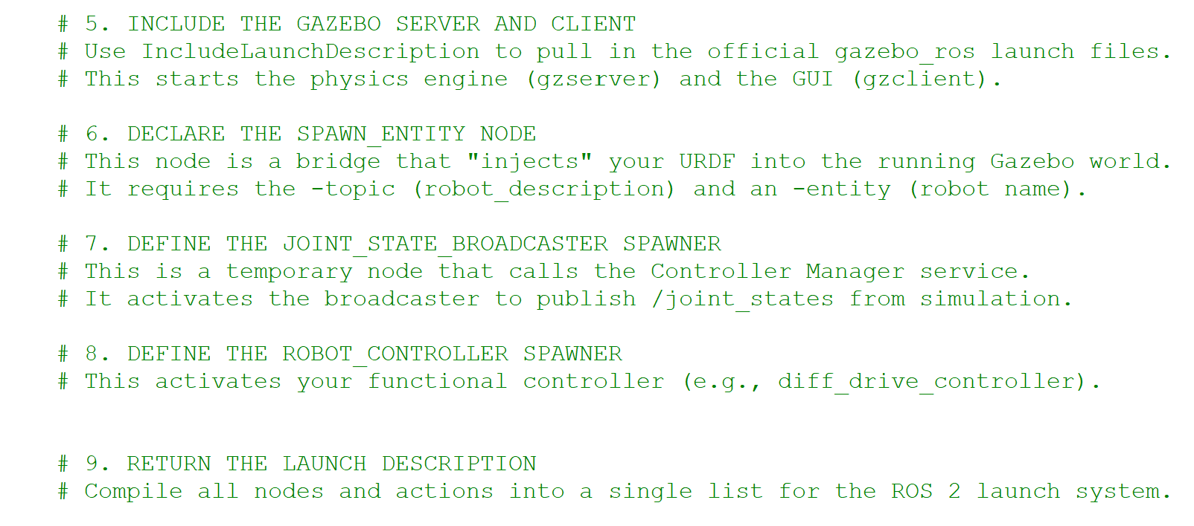
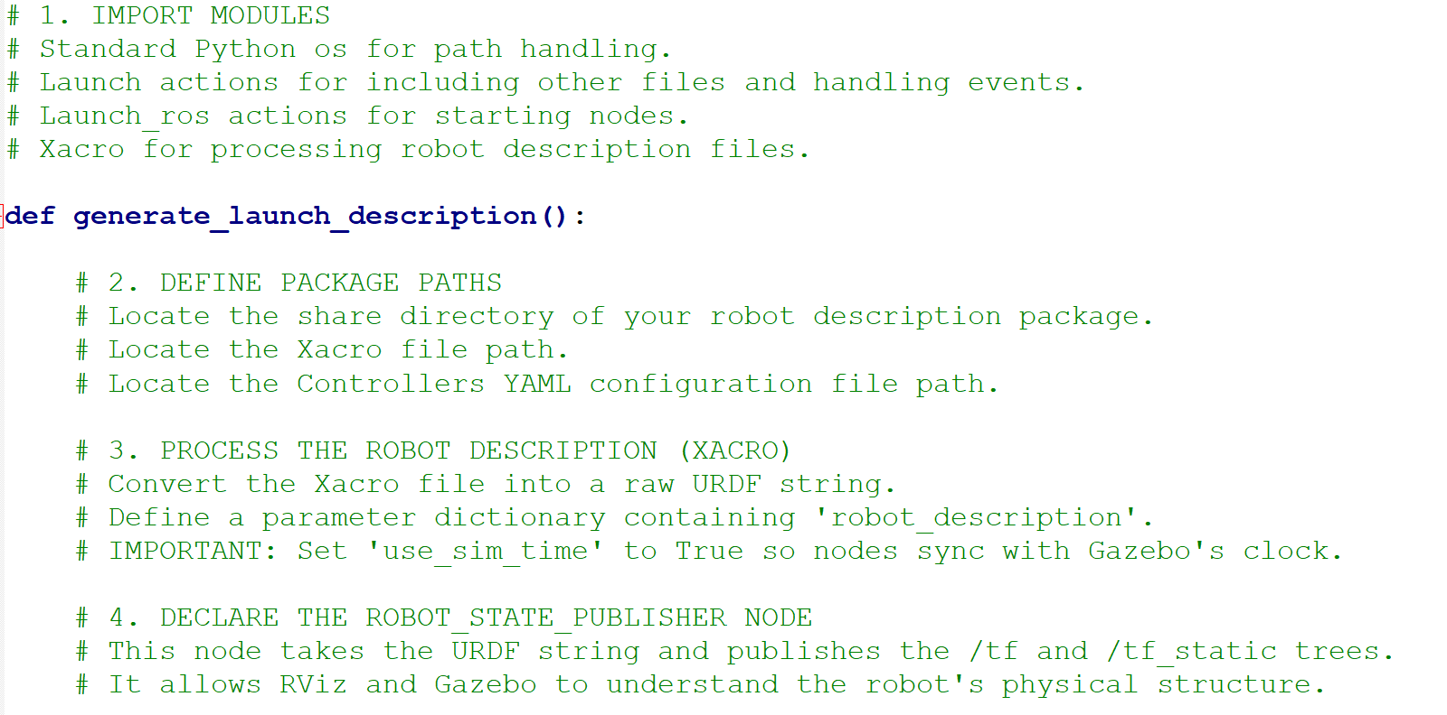
Implementing ROS Control
Step5: write a .launch file

Slide 22
Implementing ROS Control
Step 6: Control your robot via ros control topics

